Slide 1
FAIRagro Titel
Name Mustermann im Namen des FAIRagro Konsortiums
Leibniz-Zentrum für Agrarlandschaftsforschung

Slide 2
TOP 1
TOP 2
TOP 3
TOP 4
TOP 5
TOP 6
TOP 7
TOP 8

Slide 3
Folientitel
Überschrift Medium
Überschrift 1
  Überschrift 2
Text Text Text
Text medium
Text medium kursiv
Text kursiv
Text kleiner grün
Text klein
Text klein grau
Aufzählungsebene 1
  Aufzählungsebene 2

Slide 4
Folientitel
Key challenges
Food nutrition security
Climate Change
Biodiversity loss
Natural resources degradation
…
Key challenges
Food nutrition security
Climate Change
Biodiversity loss
Natural resources degradation
…
Abb. 1

Slide 5
Folientitel
Überschrift 1
Text Text Text
Überschrift 2
Crop sciences
Soil sciences
Agri-environmental sciences
Abbildung 1

Slide 6
Folientitel
Überschrift 1
Text
Text

Slide 7
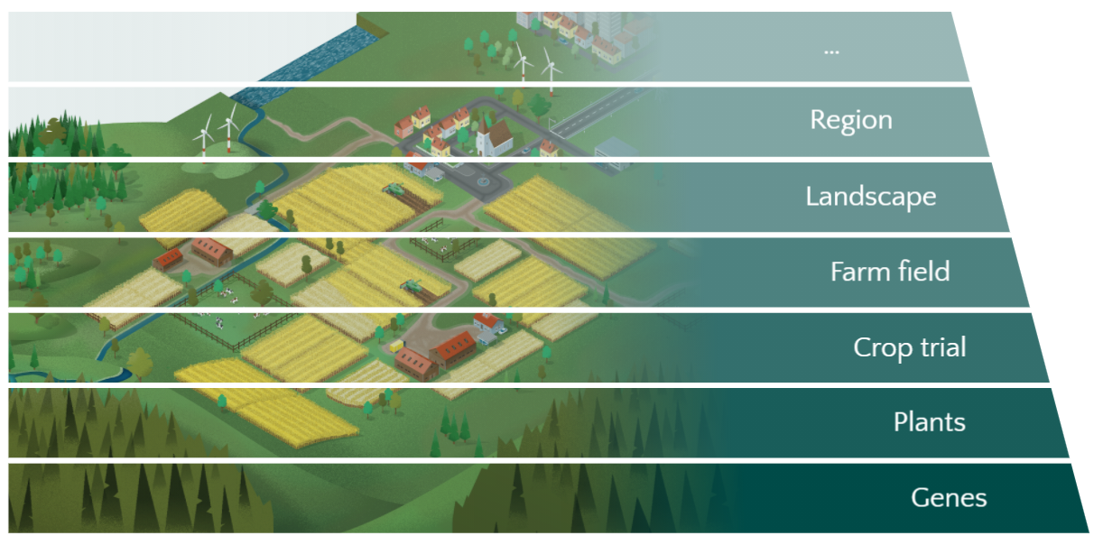
Our use cases
Flagship use cases on relevant sustainability problems
Scales
Use cases
UC6
Integrated modeling
UC2
Agronomy
UC4
Long-term experiments
UC3
Pest & Diseases
UC5
Sensor systems
UC1
Breeding

Slide 8



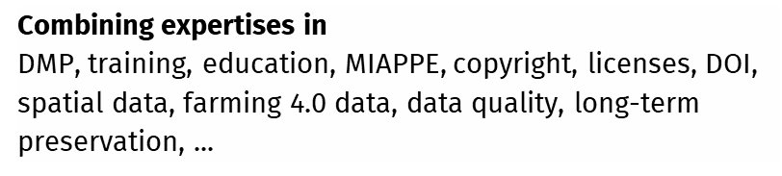



Formen und Grafiken
Data Steward Service Center
Data Steward Service Center
Use cases
H
E
L
P
D
E
S
K
H
E
L
P
D
E
S
K
UC1
Breeding
UC2
Agronomy
Coordinator
Data Stewards
Coordinator
Data Stewards
UC3
Pest &
disease
Combining expertises in
DMP, training, education, MIAPPE, copyright, licenses, DOI, spatial data, farming 4.0 data, data quality, long-term preservation, ...
UC4
LTE
UC5
Sensor
systems
UC6
Integrated
modeling
UC6
UC6
UC6

Slide 9
Outcomes
Support, guide and train the community
1st and 2nd level
support
Data stewards, helpdesk
Training
Education materials, training concepts
Cultural change Roadshows, conferences, workshops
Agrosystem
community
FAIRagro PORTAL
Infrastructure-based services
Search & inventory
Networked RDIs; interlinking existing RDIs, NFDI-RDC
Reproducible science
Scientific Workflow Infrastructure
Data quality & plausibility
Improve data assessment

Slide 10

















Agrosystem research: current RDM challenges
Heterogeneous landscape of data infrastructures
Where should I
publish my data?
Where and how can I find e.g. soil data?
How can I best publish my data?
Which measuring
method was used
for e.g. soil pH?
Heterogeneous data and standards
Agrosystem
Community
ICASA
Can I trust
the data?
Is the dataset
complete?
Data quality
Are the data e.g.
yields plausible?
Am I allowed to publish my data, e.g. farmers survey?
Legal questions
Is the aerial photo
I found restricted?

Slide 11


Plant
Further development
of the community
Environment
Soil
Agrosystem
community
Flagship use cases addressing RDM
demands
Data Stewards as
interfaces between researchers and infrastructure

Slide 12
Spalte A | Spalte B | Spalte C | Spalte D
xxxxxxxxxxxxxxxxxxxxxxxx | xxxxxxxxxxxxxxxxxxxxxxxx | xxxxxxxxxxxxxxxxxxxxxxxx | xxxxxxxxxxxxxxxxxxxxxxxx

Slide 13
TOP 2
„FAIRagro´s contribution to the development of the NFDI“
Summary
xxxxxxxxxxxxxxxxxxxxxxxxxxxxxxxxxxxxxxxxxxxxxxxxxxxxxxxxxxxxxxxxxx
Xxxxxxxxxxxxxxxxxxxxxxxxxxxxxxxxxxxxxxxxxxxxxxxxxxxxxxxxxxxxxxxxxxxxxxxxxxxxxxxxxxxxxxxxxxxxxxxxxxxxxxxxxxxxxxxxxxxxxxxxxxxxxxxxxxx
Überschrift 2
Text

