Slide 1
FAIRagro in a nutshell
Prof. Dr. Frank Ewert and Dr. Xenia Specka on behalf of the FAIRagro Konsortium
Leibniz Centre for Agricultural Landscape Research (ZALF)

Slide 2




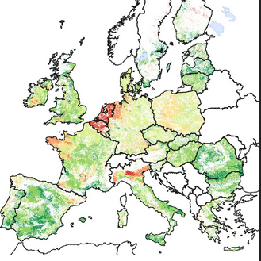
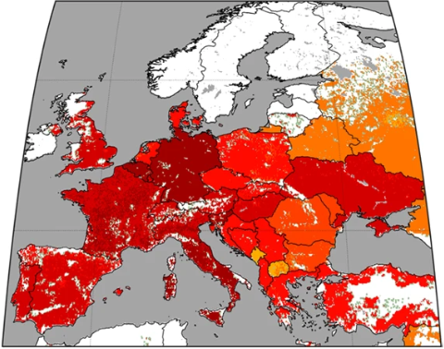
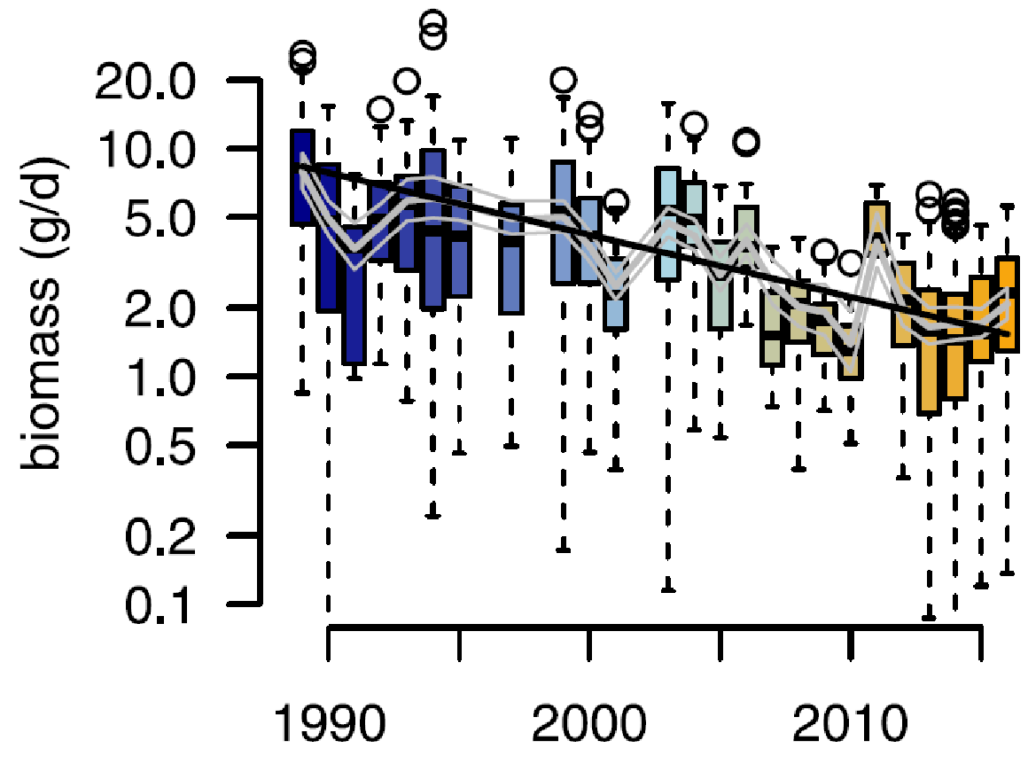
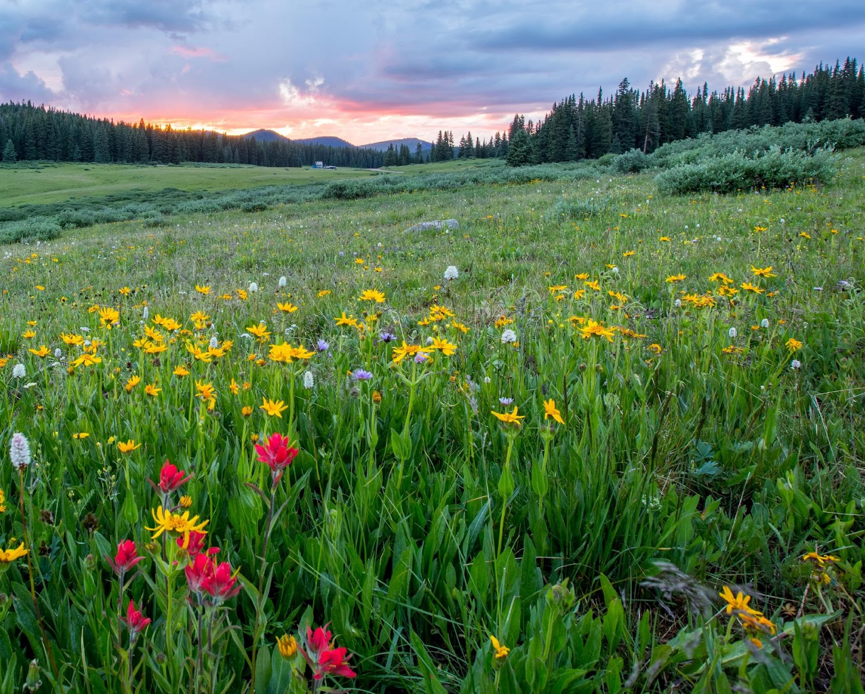
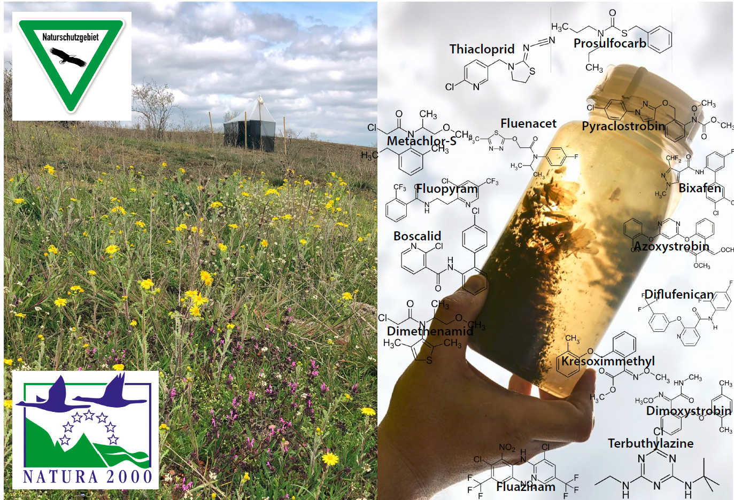
Sustainable crop production: challenges and targets
Key challenges
Food nutrition security
Climate Change
Biodiversity loss
Natural resources degradation
Environmental pollution
…
Targets for 2030 (EU F2F Strategy)
Reduce use of chemical pesticides by 50%
Reduce nutrient losses by > 50%
(reducing fertilizer use by > 20%)
Increase organic farming on > 25%
of EU´s agricultural land
…
Nitrogen surplus
Decline in insect biomass
Loss of ecosystem services
Glyphosate application rates
De Vries (2021)
Maggi et al. (2019)
Hellmann et al., (2017)
J. Holland (Unsplash)

Slide 3
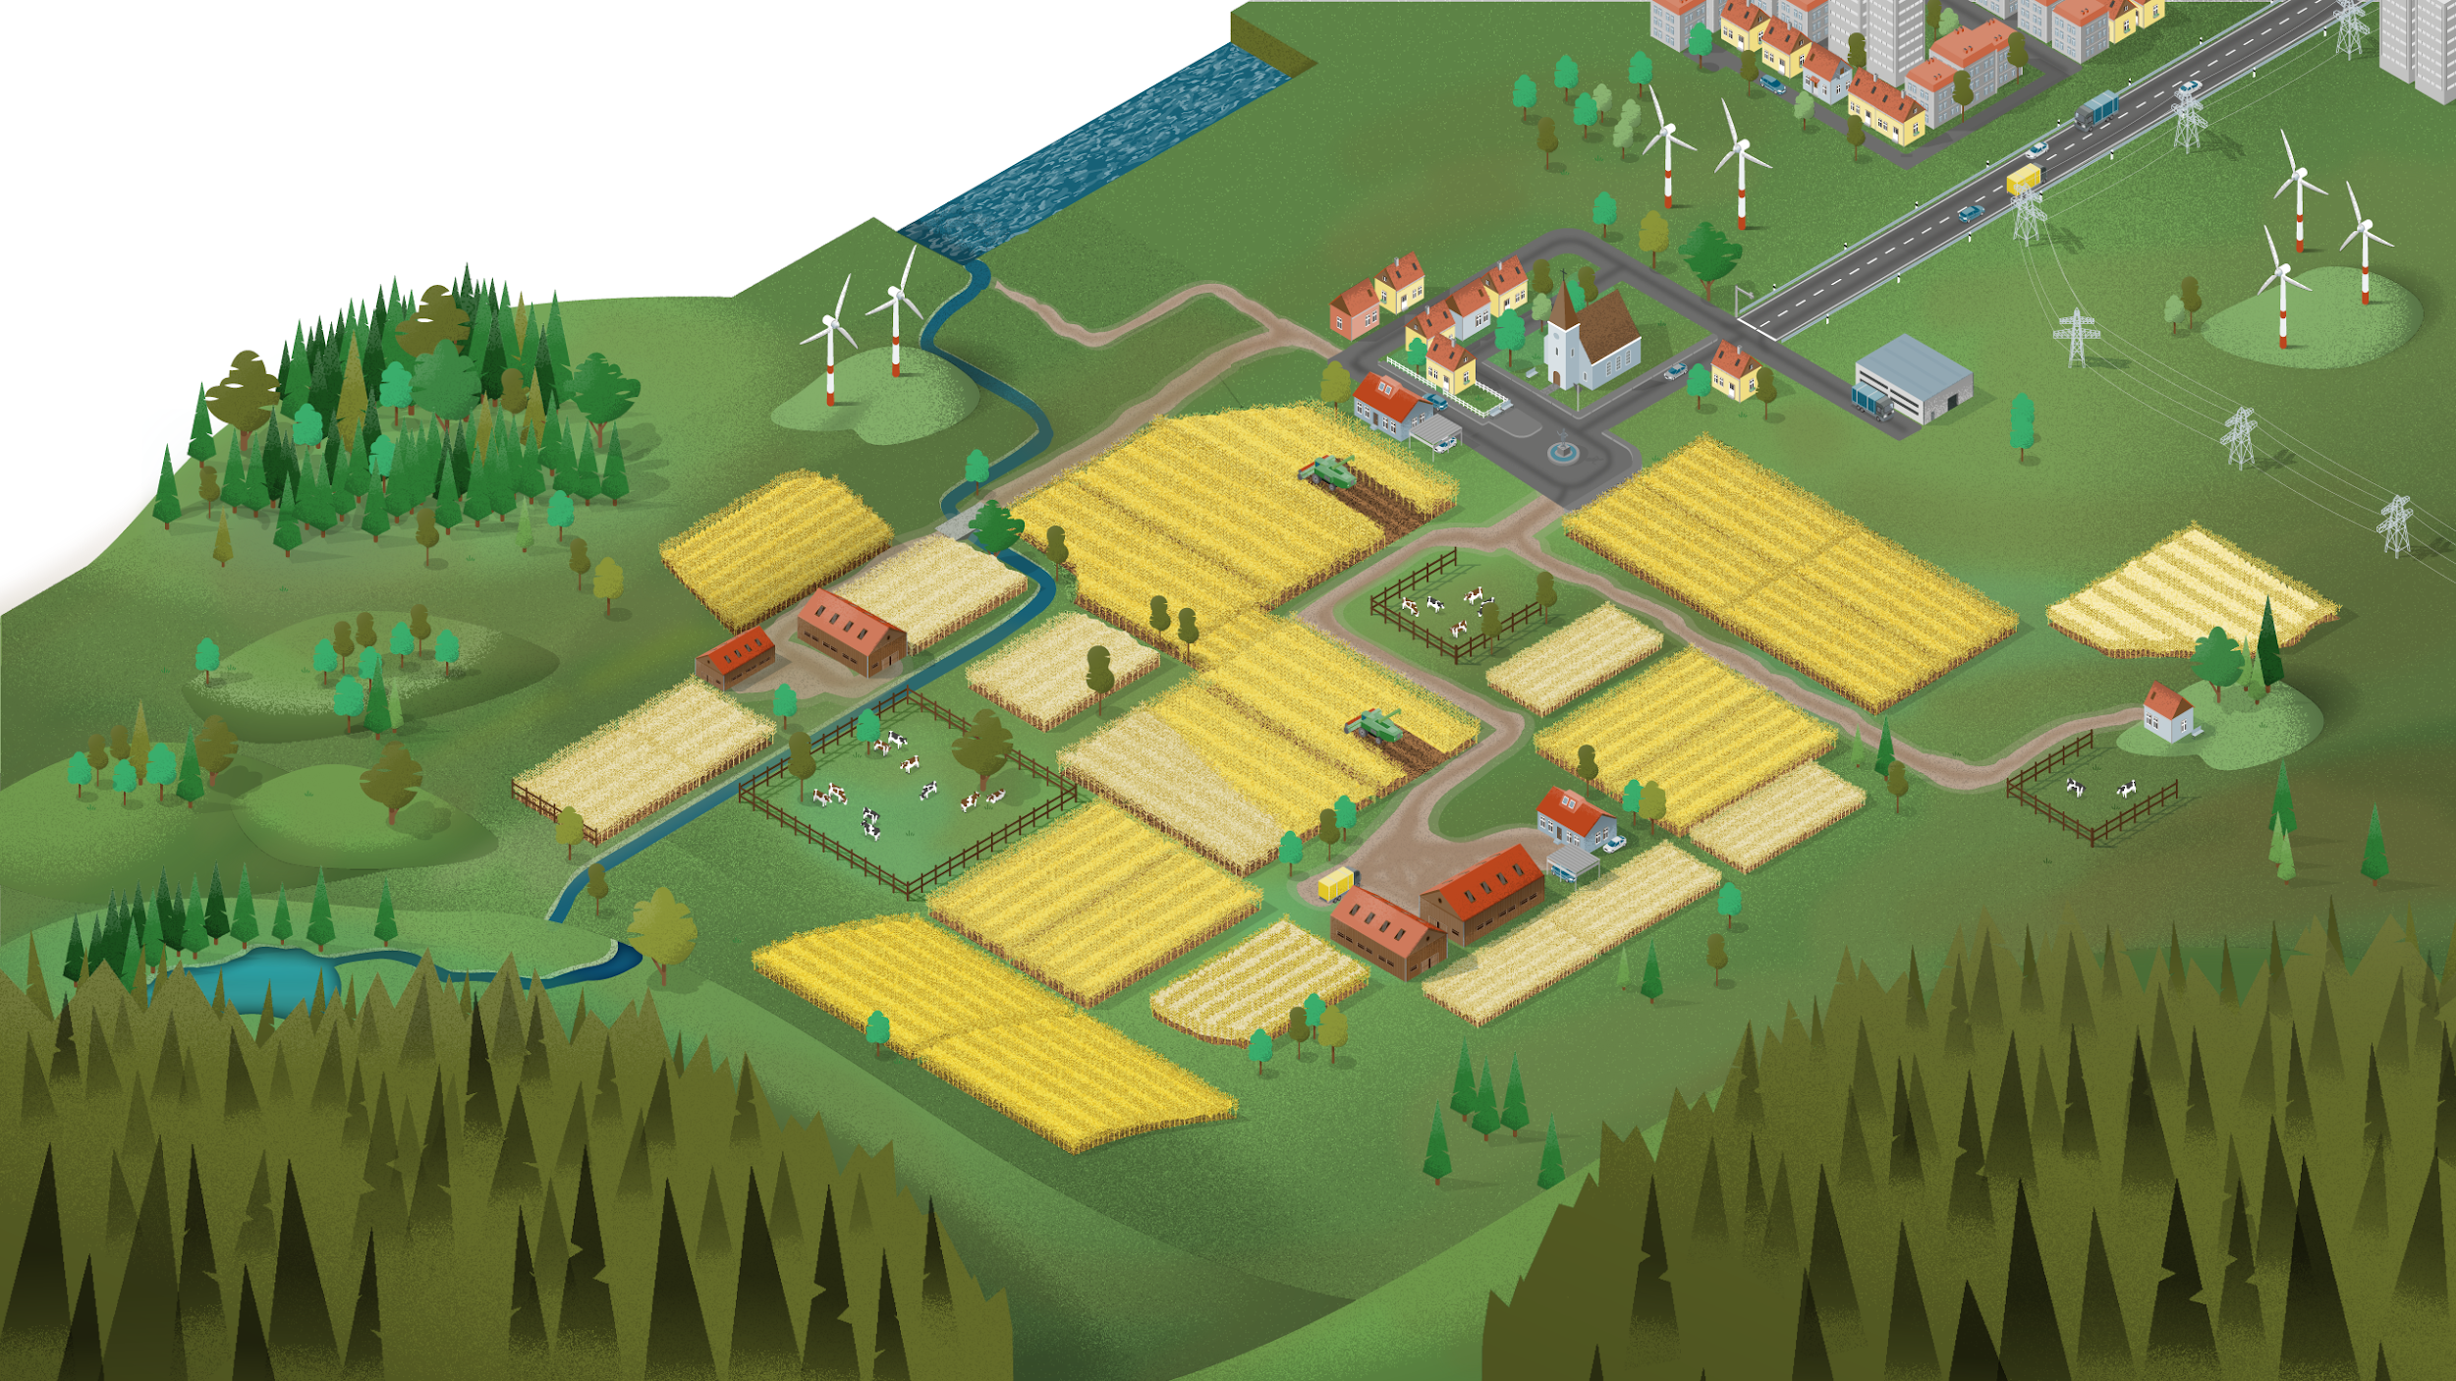
FAIRagro domain: scales, disciplines and data categories
→ Sustainable solutions require an agrosystem approach
Agrosystems: Crop production, ecosystems and landscapes whose sustainable management and development are based on systems understanding of plant-soil-environment interactions, taking into account cross-scale processes and relationships
Agronomy
Crop physiology/ecology
Plant pathology
Plant nutrition
Crop breeding
Crop functional genetics
Crop bioinformatics
Soil biology/chem./physics
Soil microbiology
Soil hydrology
Agroecology
Agrobiodiversity
Remote sensing
Modelling
...
Scales
Subjects and disciplines
…
Plant
Region
Landscape
Farm field
Environment
Soil
Crop trial
Plants
Genes

Slide 4





FAIRagro domain: scales, disciplines and data categories
→ Sustainable solutions require an agrosystem approach
Agrosystems: Crop production, ecosystems and landscapes whose sustainable management and development are based on systems understanding of plant-soil-environment interactions, taking into account cross-scale processes and relationships
Scales
Data categories
Subjects and disciplines
…
Plant
time-series
geo data
Region
Landscape
Farming 4.0
sensitive data
Farm field
Environment
Soil
Crop trial
legacy data
omics data
Plants
Genes
…

Slide 5












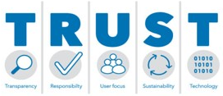





Agrosystem research: current RDM challenges
Heterogeneous landscape of data infrastructures
Where should I
publish my data?
Where and how can I find e.g. soil data?
How can I best publish my data?
Which measuring
method was used
for e.g. soil pH?
Heterogeneous data and standards
Agrosystem
Community
ICASA
Can I trust
the data?
Is the dataset
complete?
Data quality
Are the data e.g.
yields plausible?
Am I allowed to publish my data, e.g. farmers survey?
Legal questions
Is the aerial photo
I found restricted?

Slide 6
Agrosystem research: current RDM challenges
Current
research data management (RDM)
is
unFAIR
→ constraining required advances
in agrosystem research
Heterogeneous landscape of data infrastructures
Heterogeneous data and standards
ICASA
Data quality
Legal questions

Slide 7


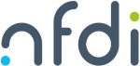

Our aims and current status of our community
FAIRagro aims to advance agrosystem research through collaborative RDM to enable and support linkages across disciplines, scales and methods
Further development
of the community
Well established agrosystem research domain
Good level of integration of different disciplines
Strong (inter)national networks & visibility
Joint involvement of researchers and data experts
Agrosystem
community
Flagship use cases addressing RDM
demands
Concrete actions
with NFDI consortia
and (inter)national
programs
Data Stewards as
interfaces between researchers and infrastructure

Slide 8
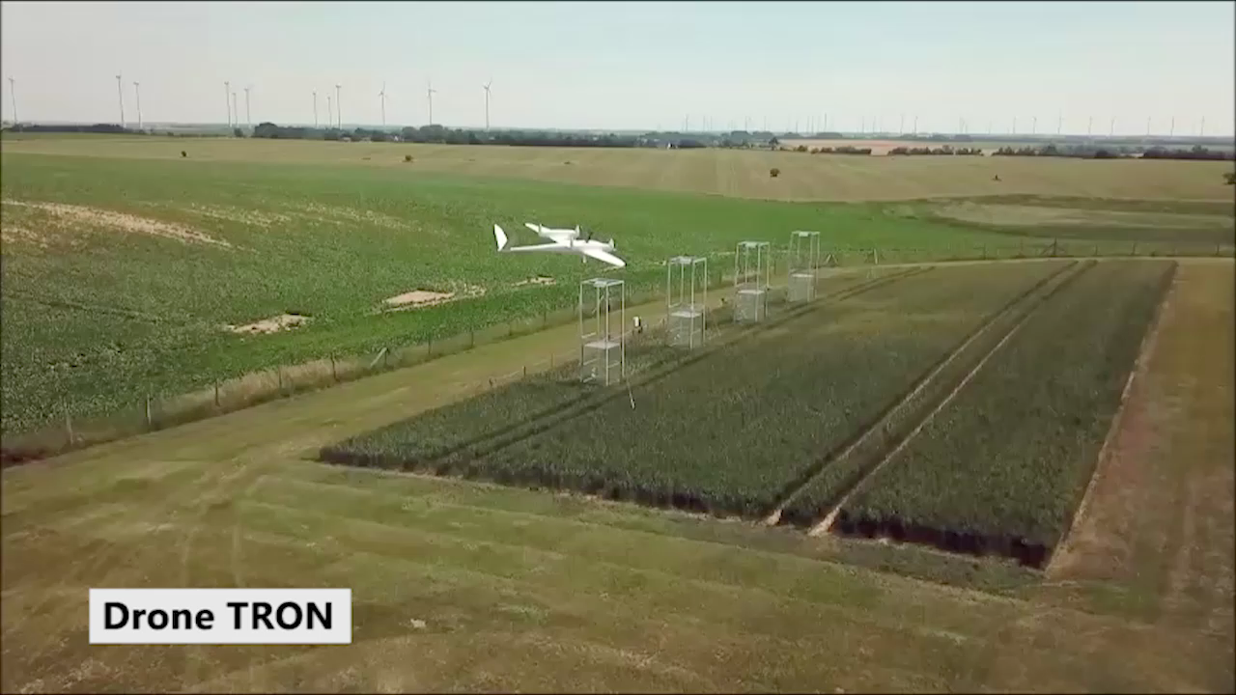
Our objectives: FAIR data for agrosystem research
Foster a cultural change towards FAIR and collaborative RDM.
Provide interoperable infrastructures to enable integrated research
Findable
Accessible
Interoperable
Reusable
Establish standards, guidelines and best-practices to enable FAIR RDM.
Enable reproducible research results and data analysis workflows.
Provide legal certainty to data providers and users for sensitive data.
Ensure data quality via domain-specific measures.

Slide 9
Our partners: leading institutions in the agrosystem domain
11 (Co-)applicants + 19 participants
Universities
Universities of applied sciences
Research institutes
Federal (research) institutes
Infrastructure facilities
Governmental institutions
Professional scientific associations
Representing important disciplines in
Crop and vegetable sciences
Soil sciences
Agri-environmental sciences
Socio-economics

Slide 10

Agrosystem research: current RDM challenges
Use cases
Data Steward Service Center
FAIRagro
Services
UC1
Breeding
H
E
L
P
D
E
S
K
Networked
RDIs
UC2
Agronomy
Coordinator
Data Stewards
Search & Inventory
UC3
Pest &
disease
Combining expertises in
DMP, training, education, MIAPPE, copyright, licenses, DOI, spatial data, farming 4.0 data, data quality, long-term preservation, ...
Agrosystem community
Scientific Workflow Infrastructure
UC4
LTE
UC5
Sensor
systems
…
UC6
Integrated
modeling
Network of data stewards & RDM knowledge exchange with NFDI consortia (e.g., NFDI4Earth, NFDI4BioDiversity, DataPLANT, NFDI4Health)

Slide 11
Timeline & project duration
All Measures started
38 employess (Postdocs)
  Community Summit (June)
    1. Use Case Call (June-July)
      New participants (IGZ, Uni Rostock, HUI Berlin…)
      Use Case Pilots start (Nov 1st)
Proposal submission
review & decision
< 2023
2023
2024
2025 - 2027
Project start
1. March 2023
Duration: 5 years
  DSSC started (Help Desk, User Support)
FAIRagor Portal
Networked infrastructure
      OneNFDI

Slide 12
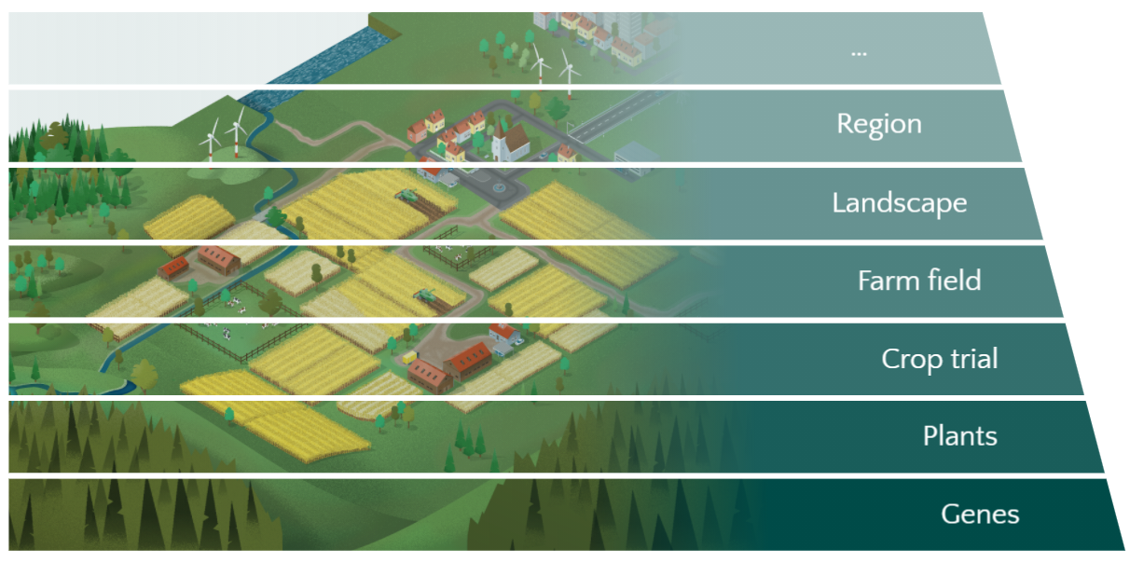
Our flagship use cases
Flagship use cases on relevant sustainability problems
Scales
Use cases
UC6
Integrated modeling
UC2
Agronomy
UC4
Long-term experiments
UC3
Pest & Diseases
UC5
Sensor systems
UC1
Breeding

Slide 13
Our new use cases & pilots
Demands of our community
Scales
Use case Pilots
Show case
Tools for Extreme Events
Pilot 1
Socio-economic Information
Pilot 2
Synchronization Horticulture Data
Pilot 3
Arable weed data
Pilot 4
BrAPI Integration

Slide 14
Further development of FAIRagro
UC
UC2
Potential use cases and domains
UC1
UC
Expanding FAIRagro into a broader NFDI for agricultural sciences
Agrosystem
UC6
UC3
Onboarding
UC
UC
UC
UC
UC5
Further research
domain
UC4
UC
Catalog of UC criteria
Recommendations of the CAB
Decision by SC
UC
UC
UC
UC
UC
Animals
UC
Onboarding
UC
UC
UC

Slide 15
Outcomes
Support, guide and train the community
1st and 2nd level
support
Data stewards, helpdesk
Training
Education materials, training concepts
Cultural change Roadshows, conferences, workshops
Agrosystem
community
FAIRagro PORTAL
Infrastructure-based services
Search & inventory
Networked RDIs; interlinking existing RDIs, NFDI-RDC
Reproducible science
Scientific Workflow Infrastructure
Data quality & plausibility
Improve data assessment

Slide 16

























Links to (inter-)national networks, institutions and programs
Agrosystem related networks,
institutions and programs
Research data managements (RDM)
networks
To develop next gen agrosystem RDM → to advance agrosystem research

Slide 17
Thank you

